Slide 1
Grapes
Anoshenko Daniil
Rogoza Kirill
Sergey Rogachev
Pham Manh
Denune Pravira

Slide 2
Project statement
ETL service for private data cleansing Data quality and availability is important for applications running in the framework. The framework defines so-called data modules stored on S3 or in a RDBMS. A data module is described by a json-ld compatible metadata, a collection protocol and the versioned data. The ETL service would extract data from internal corporate systems, cleanse, merge, anonymize, transform the data and upload it to a new version of a data module. Then the module can be used by machine learning applications deployed on the framework.
Project repo: <https://github.com/Neovodoo/ETL>
This report (Video link): <https://disk.yandex.ru/i/anx4nloJF--Tpg>

Slide 3



Roles
DevOps engineer
Devops engineers can integrate our service into products for continuous delivery of dataset to the trained model
Data Scientists
Can get good transformed dataset from source data as output of our service
Project Owner
Can integrate our product into projects to decrease time for update their trained models in near real time mode

Slide 4
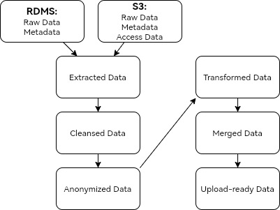
Data Flow

Slide 5

Data glossary
Merged Data
Transformed Data
Anonymized Data
Upload-ready Data
Raw Data
Meta Data
Access Data
Cleansed Data
Documentation/Source file: http://tiny.cc/GlossaryDocumentation

Slide 6
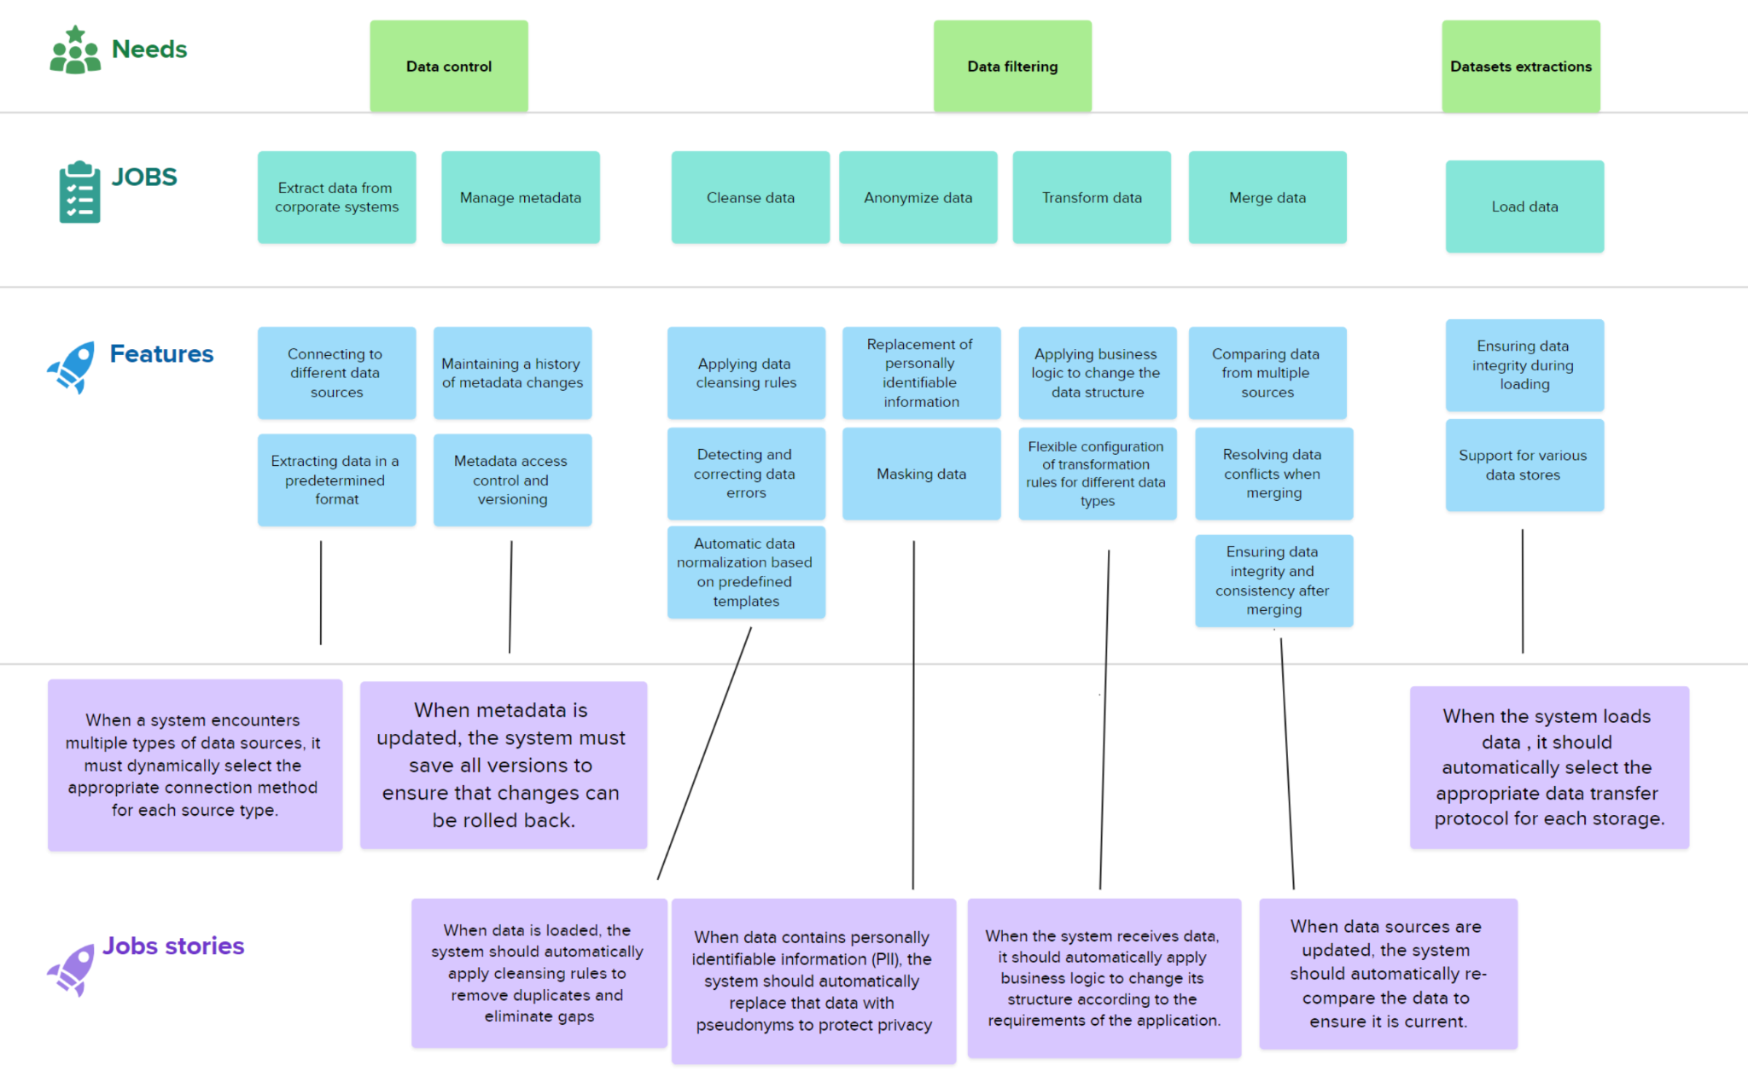
Story Map for ETL Service

